Slide 2
JDBC
JDBC stands for Java Database Connectivity. JDBC is a Java API to connect and execute the query with the database. It is a part of JavaSE (Java Standard Edition). JDBC API uses JDBC drivers to connect with the database. There are four types of JDBC drivers:
JDBC-ODBC Bridge Driver,
Native Driver,
Network Protocol Driver, and
Thin Driver
We can use JDBC API to handle database using Java program and can perform the following activities:
Connect to the database
Execute queries and update statements to the database
Retrieve the result received from the database.

Slide 3
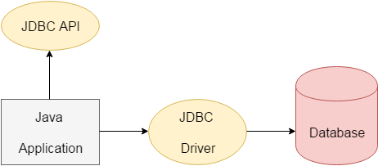
Cont.
We can use JDBC API to access tabular data stored in any relational database. By the help of JDBC API, we can save, update, delete and fetch data from the database. It is like Open Database Connectivity (ODBC) provided by Microsoft.

Slide 4
JDBC Driver
JDBC Driver is a software component that enables java application to interact with the database. There are 4 types of JDBC drivers:
JDBC-ODBC bridge driver
Native-API driver (partially java driver)
Network Protocol driver (fully java driver)
Thin driver (fully java driver)

Slide 5
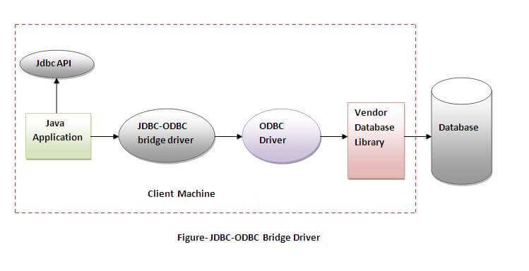
JDBC-ODBC bridge driver
The JDBC-ODBC bridge driver uses ODBC driver to connect to the database. The JDBC-ODBC bridge driver converts JDBC method calls into the ODBC function calls. This is now discouraged because of thin driver.
Advantages:
easy to use.
can be easily connected to any database.
Disadvantages:
Performance degraded because JDBC method call is converted
into the ODBC function calls.
The ODBC driver needs to be installed on the client machine.

Slide 6
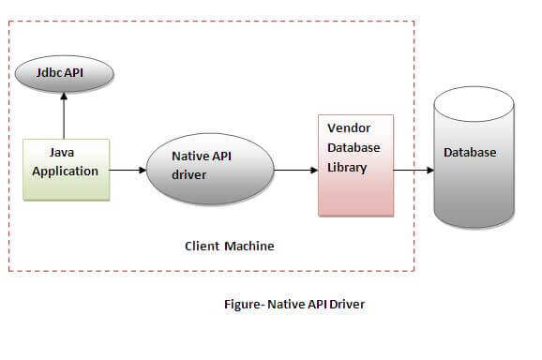
Native API
The Native API driver uses the client-side libraries of the database. The driver converts JDBC method calls into native calls of the database API. It is not written entirely in java.
Advantage:
performance upgraded than JDBC-ODBC bridge driver.
Disadvantage:
The Native driver needs to be installed on the each client machine.
The Vendor client library needs to be installed on client machine.

Slide 7
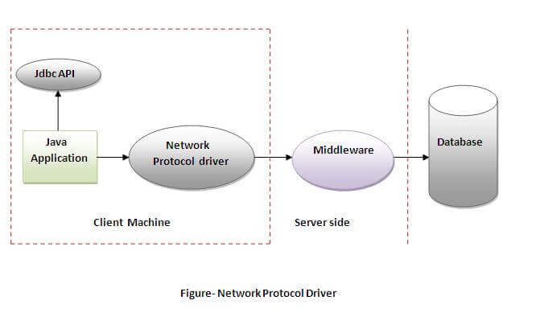
Network Protocol
The Network Protocol driver uses middleware (application server) that converts JDBC calls directly or indirectly into the vendor-specific database protocol. It is fully written in java

Slide 8
Cont.
Advantage:
No client side library is required because of application server that can perform many tasks like auditing, load balancing, logging etc.
Disadvantages:
Network support is required on client machine.
Requires database-specific coding to be done in the middle tier.
Maintenance of Network Protocol driver becomes costly because it requires database-specific coding to be done in the middle tier.

Slide 9
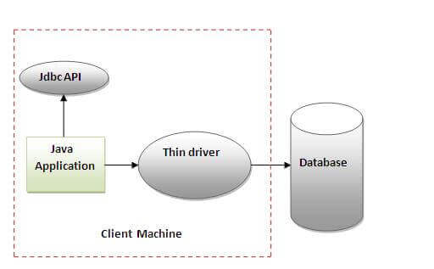
thin driver
The thin driver converts JDBC calls directly into the vendor-specific database protocol. That is why it is known as thin driver. It is fully written in Java language.
Advantage:
Better performance than all other drivers.
No software is required at client side or server side.
Disadvantage:
Drivers depend on the Database.

Slide 10
Java Database Connectivity
There are 5 steps to connect any java application with the database using JDBC. These steps are as follows:
Register the Driver class
Create connection
Create statement
Execute queries
Close connection

Slide 11
Register the driver class
The forName() method of Class class is used to register the driver class. This method is used to dynamically load the driver class.
Syntax of forName() method
public static void forName(String className)throws ClassNotFoundException
For example:
Class.forName("oracle.jdbc.driver.OracleDriver");

Slide 12
Create the connection object
The getConnection() method of DriverManager class is used to establish connection with the database.
1) public static Connection getConnection(String url)throws SQLException
2) public static Connection getConnection(String url,String name,String password) throws SQLException
Example:
Connection con=DriverManager.getConnection("jdbc:oracle:thin:@localhost:1521:xe","system","password");

Slide 13
Create the Statement object
The createStatement() method of Connection interface is used to create statement. The object of statement is responsible to execute queries with the database.
public Statement createStatement()throws SQLException
Example
Statement stmt=con.createStatement();

Slide 14
Execute the query
The executeQuery() method of Statement interface is used to execute queries to the database. This method returns the object of ResultSet that can be used to get all the records of a table.
public ResultSet executeQuery(String sql)throws SQLException
Example
ResultSet rs=stmt.executeQuery("select * from emp");
while(rs.next()){
System.out.println(rs.getInt(1)+" "+rs.getString(2));
}

Slide 15
Close the connection object
By closing connection object statement and ResultSet will be closed automatically. The close() method of Connection interface is used to close the connection.
public void close()throws SQLException
Example
con.close();

Slide 16
Java Database Connectivity with MySQL
To connect Java application with the MySQL database, we need to follow 5 following steps.
Driver class: The driver class for the mysql database is com.mysql.jdbc.Driver.
Connection URL: The connection URL for the mysql database is jdbc:mysql://localhost:3306/dbname where jdbc is the API, mysql is the database, localhost is the server name on which mysql is running, we may also use IP address, 3306 is the port number and dbname is the database name. We may use any database, in such case, we need to replace the dbname with our database name.
Username: The default username for the mysql database is root.
Password: It is the password given by the user at the time of installing the mysql database. In this example, we are going to use root as the password.

Slide 17
create a table in the mysql database
create database dbname;
use dbname;
create table emp(id int(10),name varchar(40),age int(3));

Slide 18
Example
import java.sql.*;
class MysqlCon{
public static void main(String args[]){
try{
Class.forName("com.mysql.jdbc.Driver");
Connection con=DriverManager.getConnection(
"jdbc:mysql://localhost:3306/dbname","root","root");
Statement stmt=con.createStatement();
ResultSet rs=stmt.executeQuery("select * from emp");
while(rs.next())
System.out.println(rs.getInt(1)+" "+rs.getString(2)+" "+rs.getInt(3));
con.close();
}catch(Exception e){ System.out.println(e);}
}
}

